Slide 1


SEMESTER PROJECT
By – SUDHANSHU SHEKHAR
Adm. No. – 16JE001971

Slide 2
Outlier Detection & Analysis
And
Introduction to Greedy Algorithm For Outlier Detection (only for univariate data) .

Slide 3
Content
Introduction / Motivation / Definition
Statistical-based Detection
Depth- based Detection
Deviation-based Method
Distance-based Detection
Greedy Algorithm (fastest approach)
Summary

Slide 4
Motivation for Outlier Analysis
Fraud Detection (Credit card, telecommunications, criminal activity in e-Commerce)
Customized Marketing (high/low income buying habits)
Medical Treatments (unusual responses to various drugs)
Analysis of performance statistics (professional athletes)
Weather Prediction
Financial Applications (loan approval, stock tracking)
“One persons noise could be another person’s signal.”

Slide 5
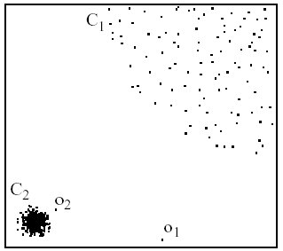
What is an outlier?
Observations inconsistent with rest of the dataset – Global Outlier
Special outliers – Local Outlier
  Observations inconsistent with their neighborhoods
  A local instability or discontinuity

Slide 6
Causes of Outliers
Poor data quality / contamination
Low quality measurements, malfunctioning equipment, manual error
Correct but exceptional data

Slide 7
Outlier Analysis – Other Methods
Statistical-based Detection
  Distribution-based, depth-based
Deviation-based Method
  Sequential exception, OLAP data cube
Distance-based Detection
  Index-based, nested-loop, cell-based, local-outliers

Slide 8
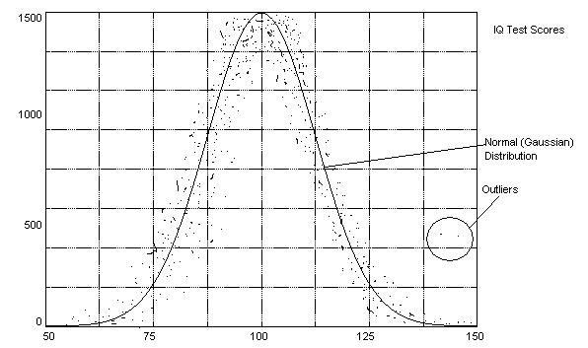
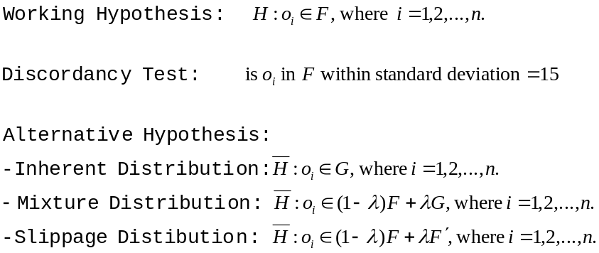
Statistical-Based Outlier Detection (Distribution-based)
Assumptions:
  Knowledge of data (distribution, mean, variance)
Statistical discordancy test
  Data is assumed to be part of a working hypothesis (working hypothesis)
  Each data object in the dataset is compared to the working hypothesis and is either accepted in the working hypothesis or rejected as discordant into an alternative hypothesis (outliers)

Slide 9
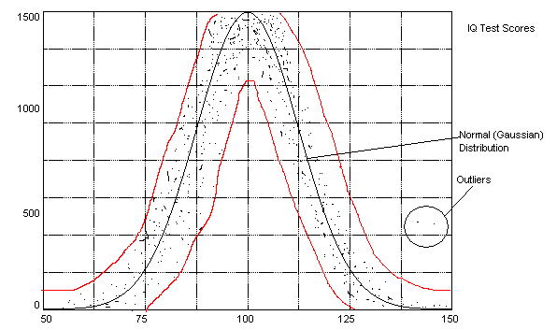
Statistical-Based Outlier Detection (Distribution-based)
Assumptions:
  Knowledge of data (distribution, mean, variance)
Statistical discordancy test
  Data is assumed to be part of a working hypothesis (working hypothesis)
  Each data object in the dataset is compared to the working hypothesis and is either accepted in the working hypothesis or rejected as discordant into an alternative hypothesis (outliers)

Slide 10
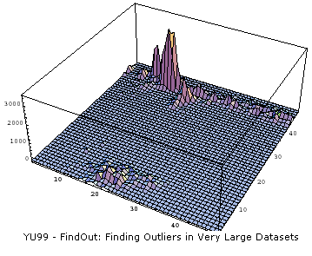
Statistical-Based Outlier detection (Depth-based)
Data is organized into layers according to some definition of depth
Shallow layers are more
likely to contain
outliers than deep
layers
Can efficiently handle
computation for k < 4

Slide 11
Statistical-Based Outlier Detection
Strengths
  Most outlier research has been done in this area, many data distributions are known
Weakness
  Almost all of the statistical models are univariate (only handle one attribute) and those that are multivariate only efficiently handle k<4
  All models assume the distribution is known –this is not always the case
  Outlier detection is completely subjective to the distribution used

Slide 12
Deviation-Based Outlier Detection
Simulate a mechanism familiar to human being: after seeing a series of similar data, an element disturbing the series is considered an exception
Sequential Exception Techniques
OLAP Data Cube Techniques

Slide 13
Distance-Based Outlier Detection
Distance-based: An object O in a dataset T is a DB(p,D) outier if at least fraction p of the objects in T are >= distance D from O
A point O in a dataset is an outlier with respect to parameters k and d if no more than k points in the dataset are at a distance of d or less from O.
Relative measurement: Let D^{k}(O) denote the distance of the k^{th} nearest neighbor of O. It is a measure of how much of an outlier point O is.

Slide 14
OUR METHOD USING
GREEDY ALGORIITHM
Calculate entropy of every vector using E = -∑p(x)log(p(x)).
Input taken is the number of outliers(k).
Initially all data in data set are Non outliers.
K scans are performed.
In each scan an outlier is detected ie the element that shows major Entropy change after removal is called an outlier in that scan.
Loop breaks after k scans, each scan giving an Outlier.

Slide 15
Data Structure Used
Given a dataset D of n points p1….pn where each point is a multidimensional vector of a single categorical attribute, we need 1 corresponding hash table as our basic data structure. The hash table has values as keys and the frequencies of the attribute values as referred values. Thus in O(1) expected time we can determine the frequency of an attribute value in the hash table.

Slide 16
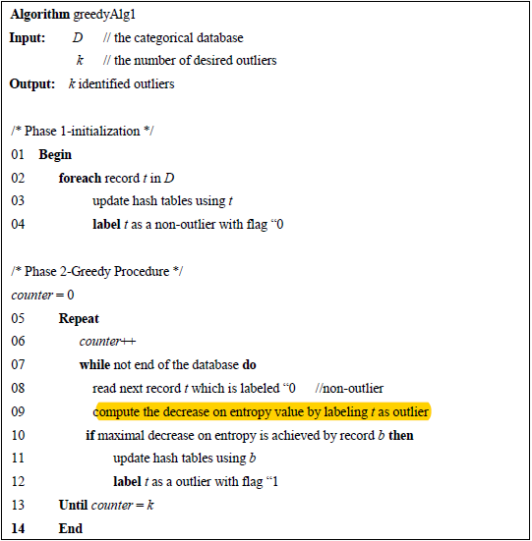
ALGORITHM USED

Slide 17
TIME COMPLEXITY
The time complexity of our algorithm is O(n*m*k*p) , where n is the size of data set , k is the number of outliers , m is the number of attributes and p is the number of distinct attribute values. However in our test code we have taken value of m as 1 for simplicity of code.
As using hash reduces the impact of p thus the net complexity is O(n*m*k).
This is far less than then LSA algorithm . O(n*m*k*l) . L>10.

Slide 18

Output for standard inputs
N was taken as 15 , a single attribute was considered and number of outliers to be detected were 3.
Corresponding values of v1-v15 were (1,1,6,13,13,14,14,14,15,15,16,18,18,18,19).
The order does not matter as we sort the given database before applying greedy algorithm.
The Output generated from our code was :

Slide 19
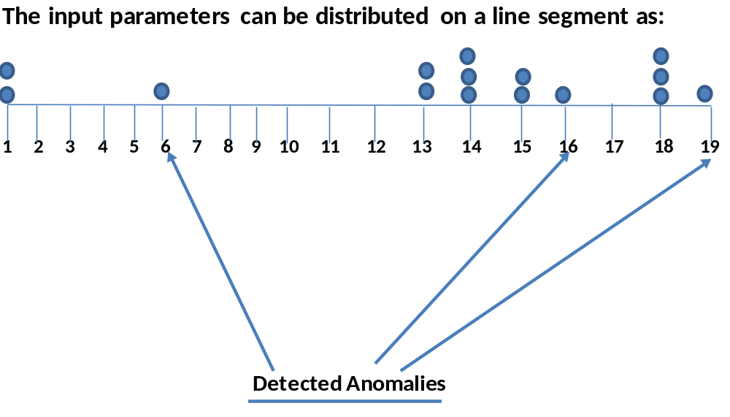
Explanation Of the output
This can be a pictorial representation of our given input :
As we can see the most probable anomalies can be detected at V6 , V16 , V19. Only these are displayed as the given output as K=3.

Slide 20
Future Work / Future Vision
The above method is applied for univariate data as the value of number of attributes is only 1 however the source code can be easily extended for m attributes.
With a few modifications and optimisations our code can be used to satisfactorily calculate the expected outputs for outliers detection in UCI Machine Learning Repository’s sample data sets of :
i)Wisconsin Breast Cancer Data
ii)Lymphogrphy Data.

Slide 21
SUMMARY
Convectional outlier mining algorithms do not handle categorical data in a satisfactory manner. To fulfil this void, the very fast greedy algorithm for mining is provided.
Experimental results show the high ability of this algorithm.
Furthermore our Algorithm solves the given problem in the time of O(n*k*m) , where n is the database size , k is the number of outliers to be detected and m is the number of attributes (we have taken this 1 in our code for simplicity ).

